Slide 1



Dashboard
View in Power BI
Last data refresh:
10/11/2024 07:30:33 UTC
Downloaded at:
13/11/2024 08:37:52 UTC

Slide 2
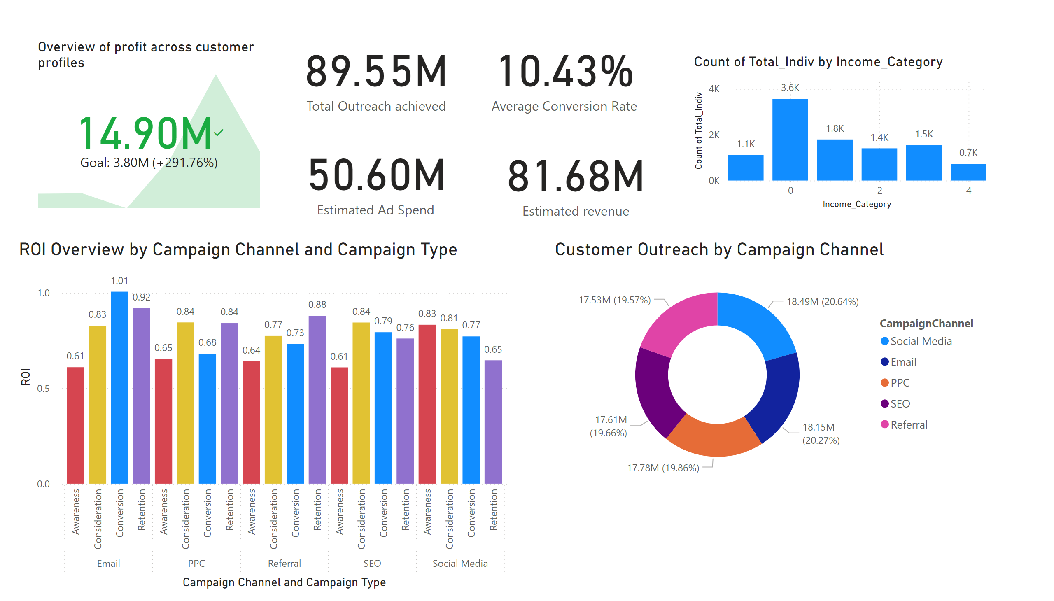
Page 1
Notes:
ROI Overview by Campaign Channel and Campaign Type
No alt text provided
card
No alt text provided
card
No alt text provided
Customer Outreach by Campaign Channel
No alt text provided
card
No alt text provided
card
No alt text provided
Overview of profit across customer profiles
No alt text provided
clusteredColumnChart
No alt text provided

